Slide 1
Detectors based on the low-pressure
MWPCs and radio frequency timer:
status and applications.
Amur Margaryan
November 2018

Slide 2
Outline
Nuclear and Hypernuclear Studies
Fundamental Studies
Methodic Studies
Methodic Studies
Low-Pressure MWPC Technique
Time-Zero FF Detector
Low EneRgy Nuclear Interaction Chamber, LERNIC
Radio Frequency Timing Technique
RF Time-Zero FF Detector
RF PMT
RF PMT based Time Correlated Single Photon Counting, TCSPC
Applications
Life Science (STED microscopy; DOT; ToF-PET,…)
Material Science (PALS,..)
High Energy Physics (LHC FP-420, ,,,)
Nuclear Physics (Direct measurement of the hypernuclear lifetimes; Decay pion spectroscopy; Auger neutron spectroscopy; Fission isomers, cluster structure of the light nuclei; photodisintegration of light nuclei, the ¹⁶O(γ,α)¹²C reaction…)
Fundamental Physics (Test of Lorentz transformations)

Slide 3
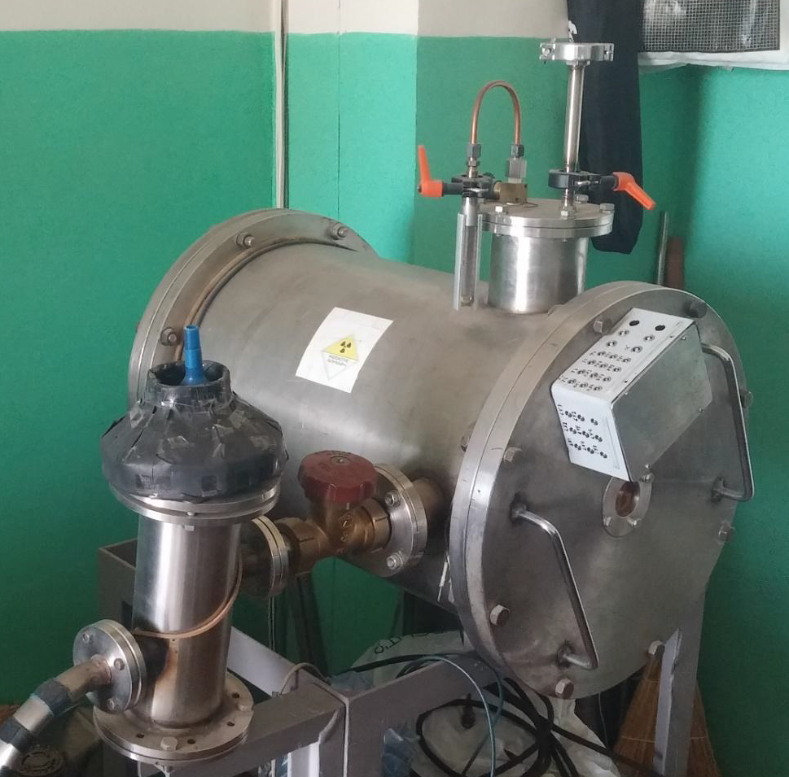
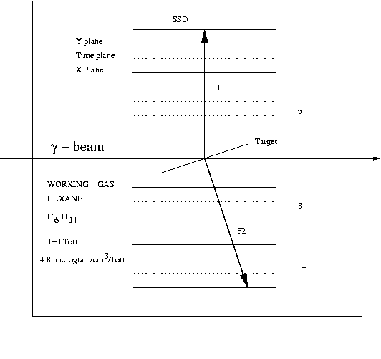
Double Velocity Double Angle FF Detector
Schematic of the detector
General view of the detector
1. A. Margaryan, Fission as a filter for heavy hypernuclei and other exotic atoms and nuclei, NIM, 357, 1995
2. L. Tang, A. Margaryan, Jlab Experiment Direct measurement of the lifetime of heavy hypernuclei, TJNAF EXP95-002, 1996
3.Grant from CRDF , Award AP1-102
4. K. Assamagan et al., Time-zero FF detector based on the low-pressure MWPCs, NIM, 426, 1999
5..Y. Song et al, Kaon, pion, and proton associated photofission of Bi nuclei, Physics of atomic nuclei 73 (10), 1707, 2019, 2010
6. X. Qiu et al. Direct measurement of the lifetime of mid-heavy hypernuclei, NP, A973, 2018
7. A. Margaryan et al. Low-pressure MWPC system for the detection of alpha-particles and fission fragments, AJP 3(4) 282, 2010
8, J.-O.Adler, A.Margaryan, Photofission of heavy actinide nuclei at MAX-lab, MAX-lab Experiment 008, 2004
9. K.Hansen, A.Margaryan, Photofission Studies of Nuclei by Virtual Photon Tagging at MAX-lab, MAX-lab Experiment 08-04, 2008

Slide 4
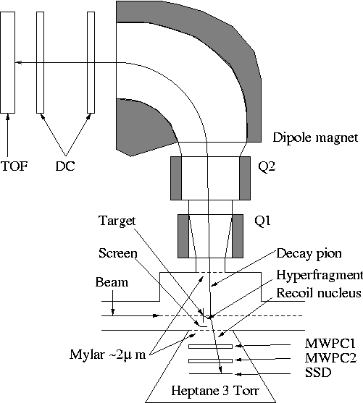
Decay pion spectroscopy of light hypernuclei
A. Margaryan, et al., Study of hypernuclei by pionic decay, Jlab LOI 07-001
L. Tang, A. Margaryan, et al., Study of light hypernuclei by pionic decay at Jlab. Jlab experiment E10-001
Yerevan Perspectives, 2009
MAMI Experiment
A. Margaryan, V. Kakoyan, S. Knyazyan, Tagged weak –π method, ANSEF Grant, Physics of Atomic Nuclei, 2011
A. Margaryan, et al., Delayed pion spectroscopy of hypernuclei, 2014
A. Margaryan, et al., RF Cherenkov picosecond timing technique for high energy physics applications, NIM 595 2008
A. Margaryan, RFPMT, optical clock and precise measurements in nuclear physics, arXiv preprint arXiv:0910.3011
A, Margaryan et al, High precission momentum calibration of magnetic spectrometrs.. , NIM, 846, 2017
A. Margaryan et al., RF Timer, ISTC project A2390
A. Margaryan et al., Decay pion spectroscopy: a new approach
Schematic of the new approach

Slide 5
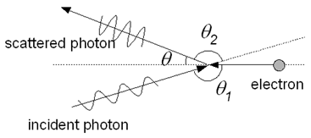

Laser Compton Backscattering: Test Lab for Lorentz Transformations
Gurzadyan, Margarian, Inverse Compton testing of fundamental physics and the cosmic background radiation, Physica Scripta, 1996
MM, Michelson-Morley, invariance to the direction (isotropy)
KT, Kennedy-Thorndike, invariance to the velocity of apparatus
JP Bocquet, et al., Limits on light-speed anisotropies from Compton scattering of high-energy electrons, Physical Review Letters 104 (24), 241601 (2010) dc/c<1.6˟10⁻¹⁴
VG Gurzadyan, AT Margaryan, The light speed versus the observer: the Kennedy–Thorndike test from GRAAL-ESRF, The European Physical Journal C 78 (8), 607 (2018) dc/c<8˟10⁻¹²
Lorentz invariance violation (LIV): Special Relativity extensions, cosmology, dark energy…
Gurzadyan, Gaskel, Margaryan and et al., Jlab LOI -12-15-002

Slide 6
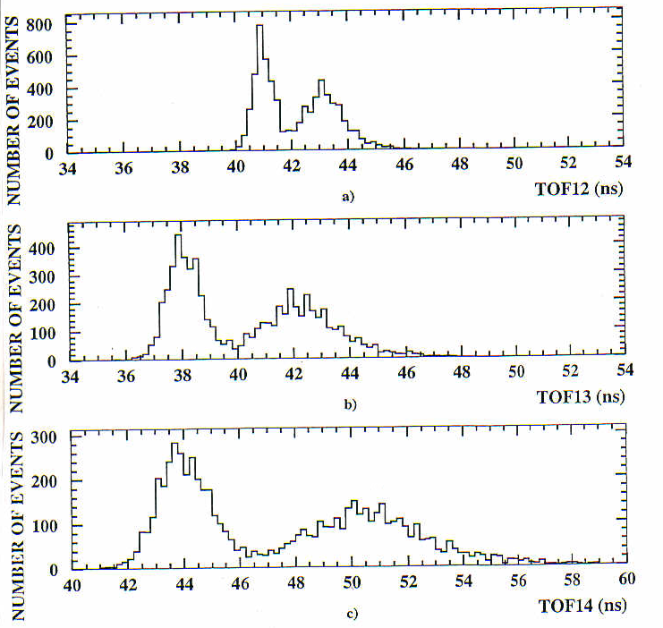
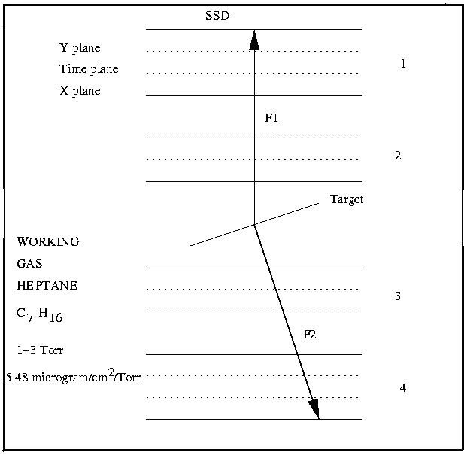
Time-of-Flight spectrum of fragments from a collimated source of Cf-252 between 1 and 2 (a), 1 and 3 (b) and 1 and 4 (c) chambers, respectively. Heptane 1.3 Torr. Time resolution 300 ps (FWHM), position resolution 0.8 mm (FWHM)
Large Acceptance FF detector

Slide 7
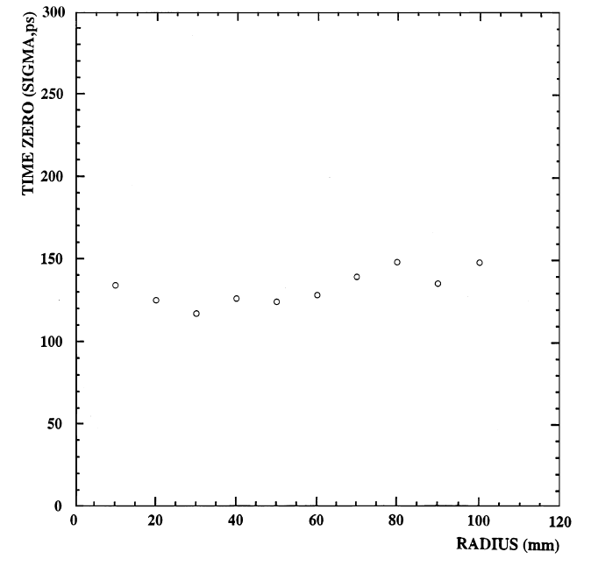
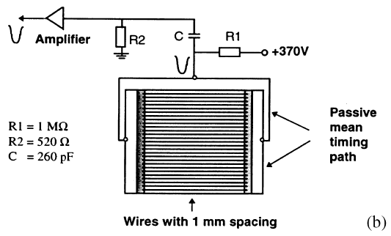
Time equalization
Time-zero with time equalized anode: Ideal for TOF measurements
Can find different applications, e.g. as a neutron detector with proper converter
Schematic of the anode electrode
Time-zero against distance from center of plane

Slide 8
Photonuclear Reactions at ELI-NP
Photoneutron reactions
γ-spectroscopy without γ detection
Separation
threshold
~ 8 MeV
Absorption
γ
γ´
γ´
β
^{A´}Y
β
Neutron TOF Spectrometer
gs
^{A}X
Nuclear Resonance Fluorescence (NRF)
Photoactivation
Photodesintegration

Slide 9
Photo neutron spectroscopy
Energy of the photo neutrons will be determined by means of TOF measurement, between photon bunches (distance 16ns), in which neutron is produced, and neutron detectors displaced on the distance L from target
Energy resolution expressed to the time resolution and transit time uncertainty
E (MeV); T (ns); L (m)

Slide 10
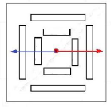
Low EneRgy Nuclear Interaction Chamber (LERNIC)
LCB γ-beam
10 cm
Protons
50 - 300 keV
Deuterons
50 - 600 keV
Alpha particles
50 - 5000 keV
More heavy e.g. C-12
>200 KeV
^{0.6 MeV} ^{α}
¹²C ~0.2 MeV
Working gas and target methylal
(OCH₃)₂CH₂ at 3-6 Torr
Heptane
C₂H₁₄ at 3-6 Torr
Schematic of the LERNIC based on the low-pressure MWPC technique
Number of target nuclei ¹⁶O is ~10¹⁷/(cmTorr)
In a single MWPC unit the ratio of efficiencies of β-particle/ α-particle is 10⁻⁴

Slide 11
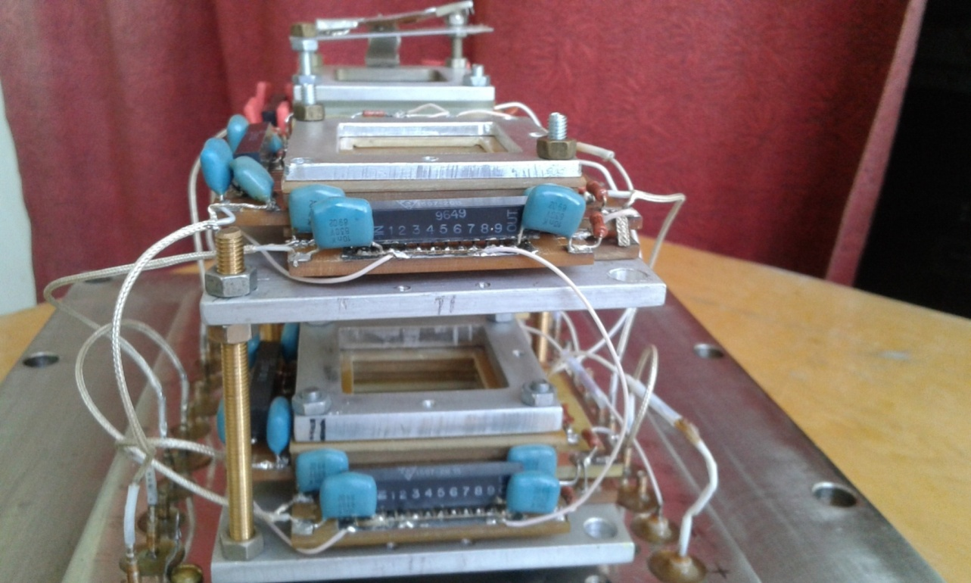
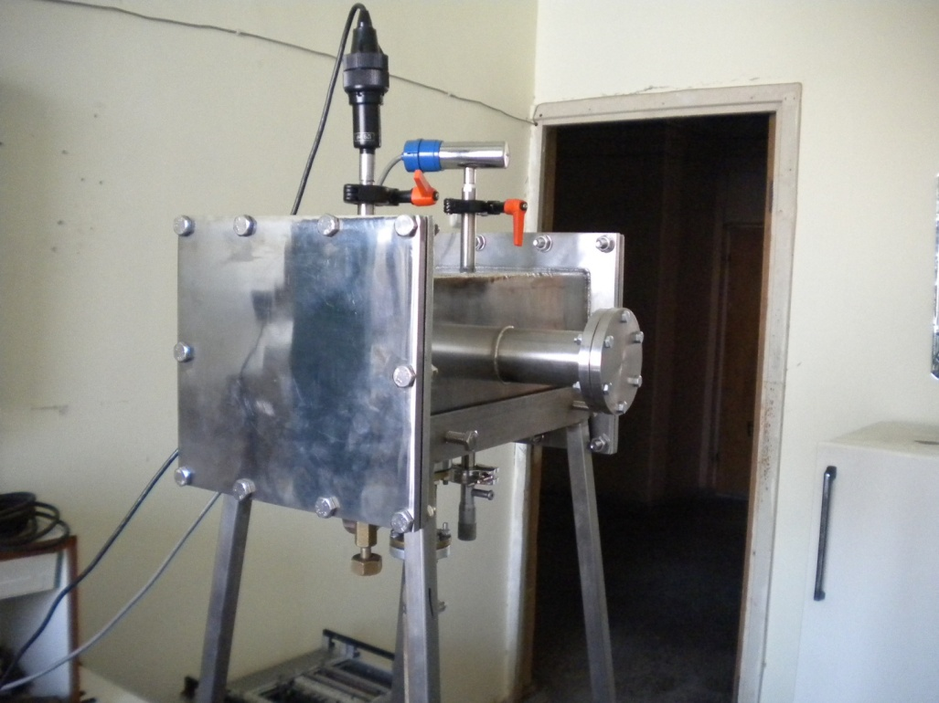
Prototype of LERNIC
General view of the detector

Slide 12
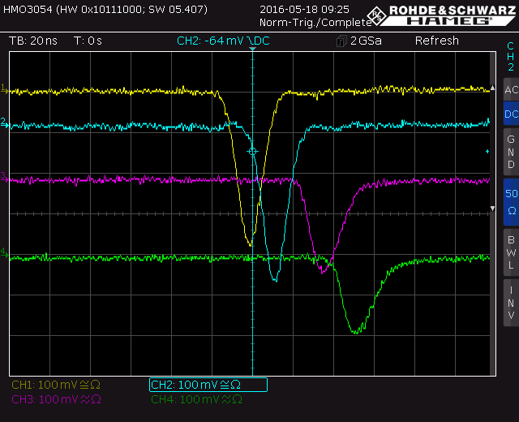
Typical electrical signals from MWPC generated by alpha particles from Pu-239

Slide 13
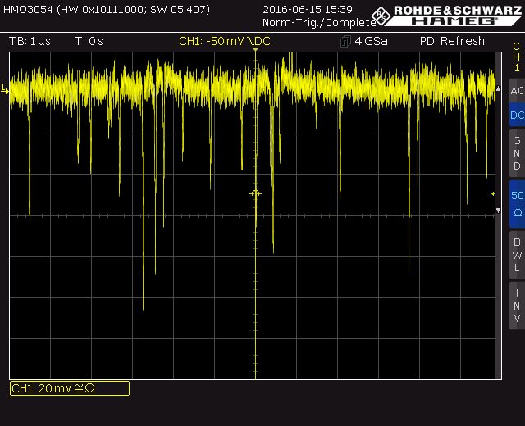
Rate capability of the low-pressure MWPC

Slide 14
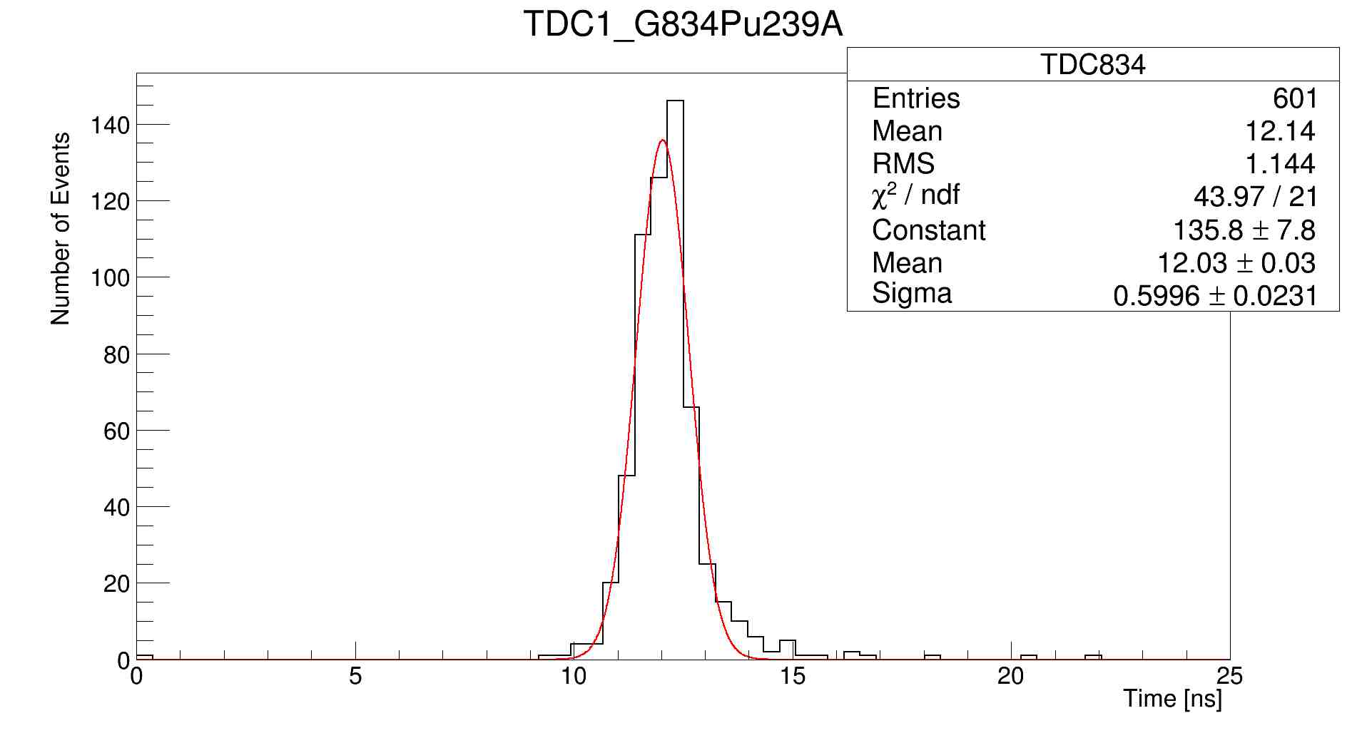
Time resolution of the MWPC single unit for α-particles is σ=400 ps
TOF between anode planes of the MWPC1 and MWPC2

Slide 15
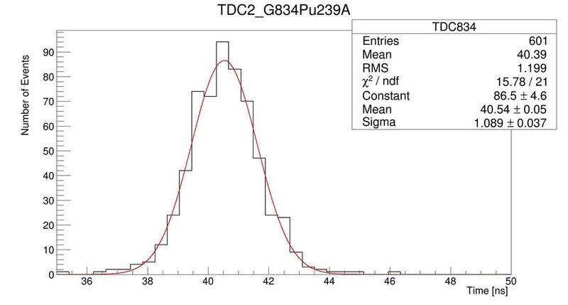
TOF between the anode and cathode planes of MWPC unit
Time resolution between the anode and cathode planes of the MWPC unit for α-particles is σ=1000 ps. Estimated position resolution is σ≤1mm

Slide 16
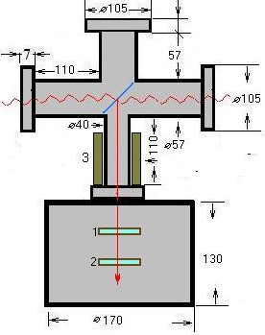
Schematic of the beam test setup
0.1 mg/cm2 U-235
Photon beam
Magnet
Nuclear Fragment
MWPC-1
MWPC-2
1-3 Torr Hexane- C₆H₁₄

Slide 17
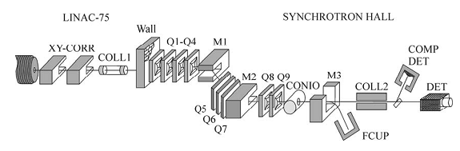

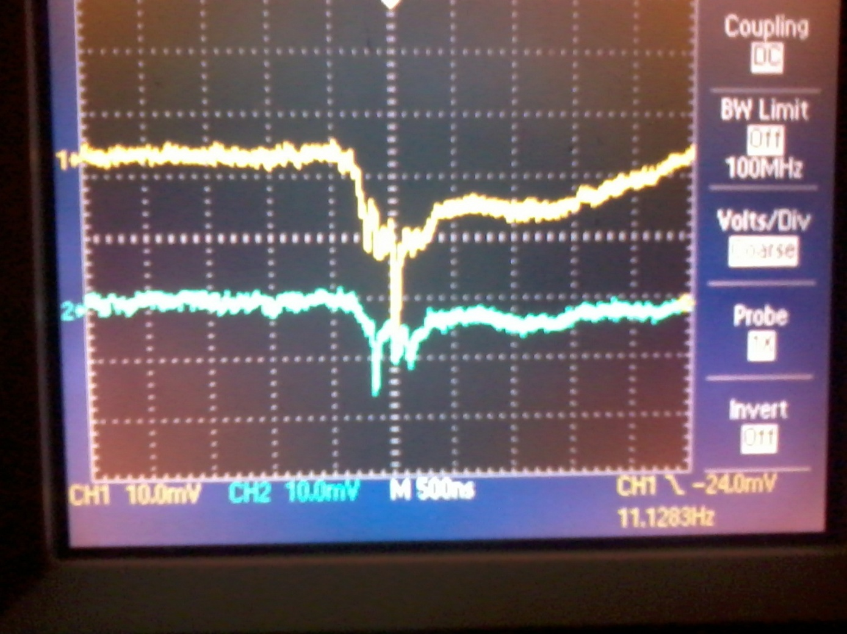
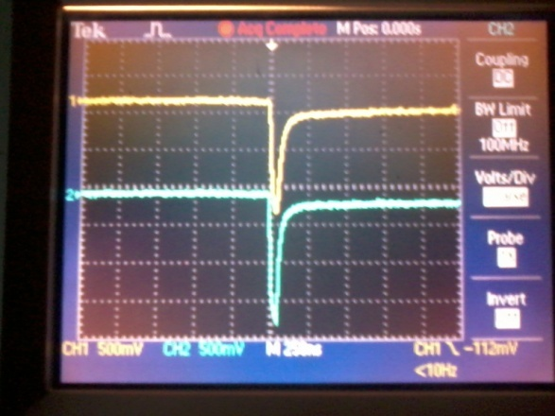
Linear electron accelerator
50 Hz, 2.8 GHz E=20 MeV
Typical electrical signals from MWPC anode planes produced in interactions of 20 MeV bremsstrahlung beam without (left) and with (right) U-235 target

Slide 18


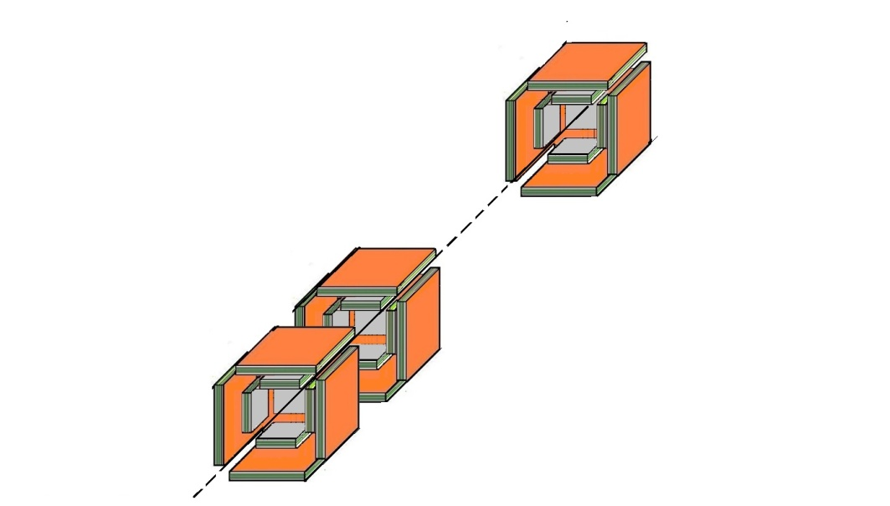
LERNIC: Applications
Proton Beam
^{0.6 MeV} ^{α}
¹²C ~0.2 MeV
Working gas
Heptanes C₂H₁₄
methylal (OCH₃)₂CH₂
Schematic of the single module
Physics Motivation
Schematic view of the experimental setup (~ 200 modules) at LCB pencil like γ-beam
¹⁶O(γ,α)¹²C;
¹²C(γ,α)⁸Be*;
¹²C(γ,3α)
p+ ¹⁶O →α+¹²C*+p;
p+ ¹²C →α+⁸Be*+p;
p+ ¹⁹F →²⁰Ne*→¹⁶O*+α; ¹²C*+⁸Be;
p+ ¹¹B →3α
1. A. Margaryan et al., Photodisintegration of Carbon into Three Alpha Particles at HIGS, HIγS, 2010
2. R. Ajvazyan et al., Active Oxygen Target for Studies in Nuclear Astrophysics with Laser Compton Backscattered γ-ray Beams, MDPI, particles, 2018; ELI-NP-2017

Slide 19
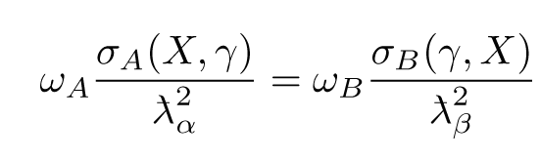
(γ,α) and (γ,p) reactions for nuclear astrophysics
The ¹⁶O(γ,α)¹²C reaction
The ²⁴Mg(γ,α)²⁰Ne reaction
The ²²Ne(γ,α)¹⁸O reaction
The ¹⁹F(γ,p)¹⁸O reaction
The ²¹Ne(γ,α)¹⁷O reaction
Direct and Inverse
Reactions

Slide 20
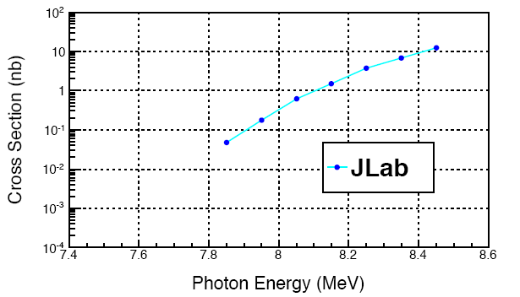

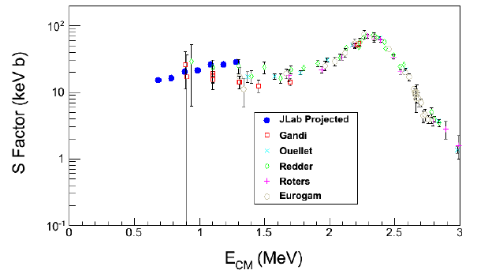
Measurement of ¹⁶O(γ,α)¹²C with a bubble chamber
and a bremsstrahlung beam
JLAB Experiment PR12-13-005
Projection of S-factor error bars
Expected Jlab unfold cross sections

Slide 21
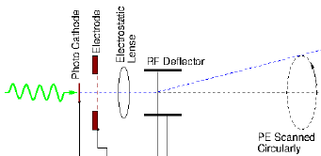

Radio Frequency Time Measuring Technique
(Streak Principle)
Streak Principle: convert time dependence
of an optical signal to a spatial dependence
Time resolution σ < 1 ps
Time stability stability - 200 fs/h
Time drift is ~10fs/s;
Image processing rate is ~few 10 kHz
Position Sensitive Detector
(X,Y) = Time
Image Readout e.g. by using CCD
- HV
Schematic of the Streak Principle
Notes:
21

Slide 22
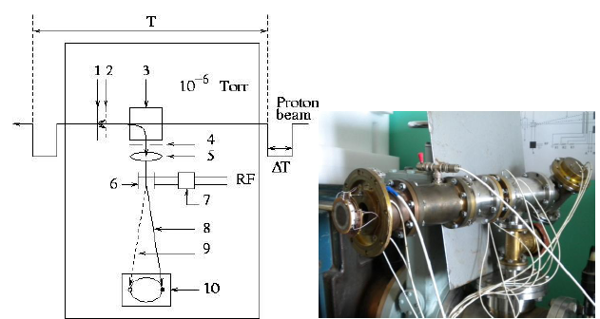
RF timing technique
Possible fields of application
Fission isomer with ns lifetimes at Cyclotron
Fission isomer with ps lifetimes at ELI NP
Ultra-high resolution timing detector for heavy ions
Hypernuclear studies
Photon beam
RF Timer, ISTC-Project, A-373, 2001
A. Margaryan, Auger neutron spectroscopy of nuclear matter at CEBAF, NP, A691, 2001
Radio frequency timer for keV electrons, ISTC-Project, A-2390, 2018
22

Slide 23
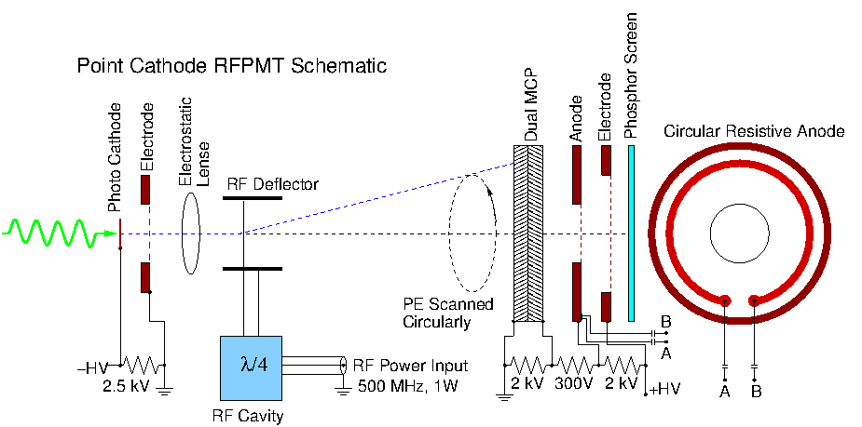
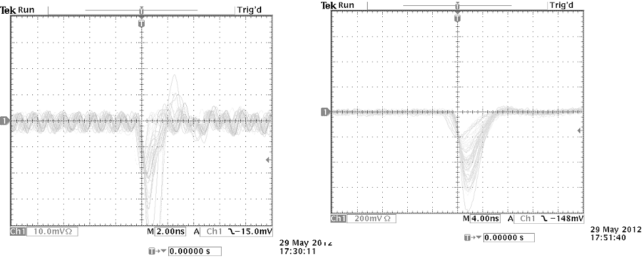
The Radio Frequency Photomultiplier Tube
Circular sweep RF deflection of photo electrons
Convert time to spatial dependence
Fast position sensitive electron detector
MCP Gain ~10⁷
Single photon counting possible
Prototype device resistive anode
Fast ~ns output pulse
Anode signal
Shaped anode signal
A. Margaryan et al., Nucl. Instr. and Meth. A 566, 321, 2006
A. Margaryan et al., US Patent , No.: US 8,138,450 B,

Slide 24
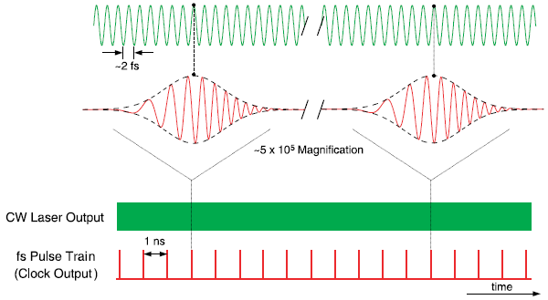
The RFPMT and Optical Frequency Comb
S. Diddams et al, Science, 2001
J. L. Hall, Nobel lecture, 2005
The fs Pulse Train as a Reference Beam
RFPMT + OFC Results:
Ultra Stable
High Resolution
High Rate
Time Correlated Single Photon
Counting Technique, TCSPC
RF synchronous with the OFC
24
Notes:
24

Slide 25
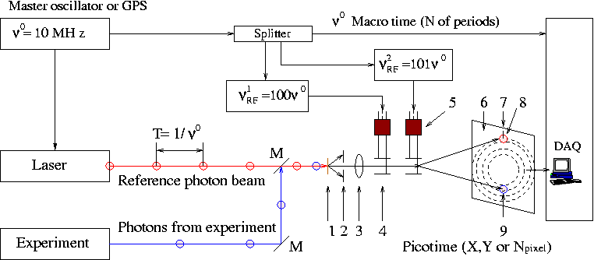

3H RF TCSPC technique
Time resolution ~1 ps
Quantization step ~1 ps
Bandwidth ~THz
Time drift is less than 10 fs/day
Throughput rate: from few MHz to THz (final goal)
A. Margaryan, “Radio frequency phototube and optical clock: high resolution, high rate and highly stable single photon timing technique”, Nucl. Instr. and Meth. A652 (2011) p. 504.

Slide 26
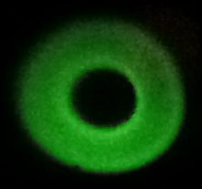
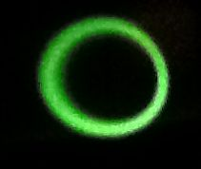
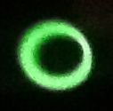
Images of the deflected 2.5 keV continuous electron beam at the phosphor screen.
^{a)}
^{b)}
^{c)}

Slide 27
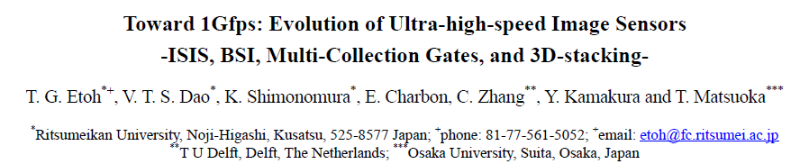
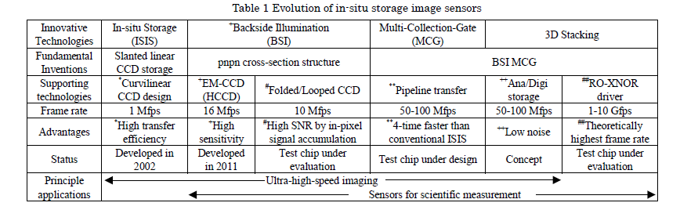

Slide 28
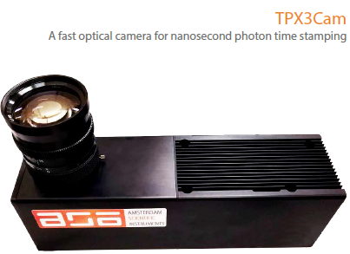
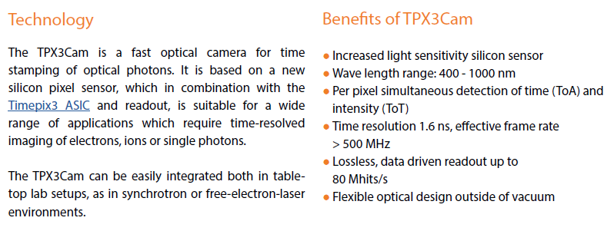

Slide 29
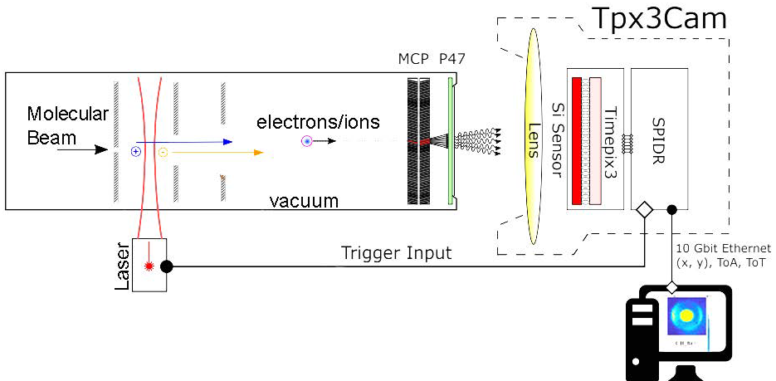
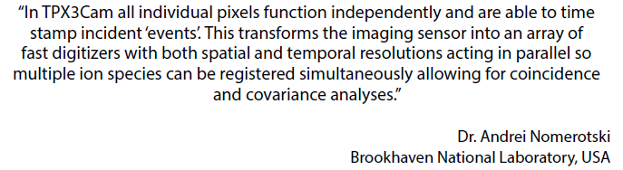

Slide 30
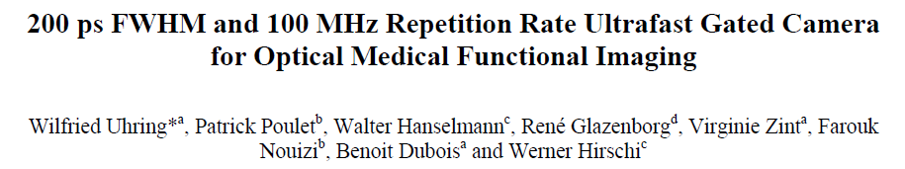
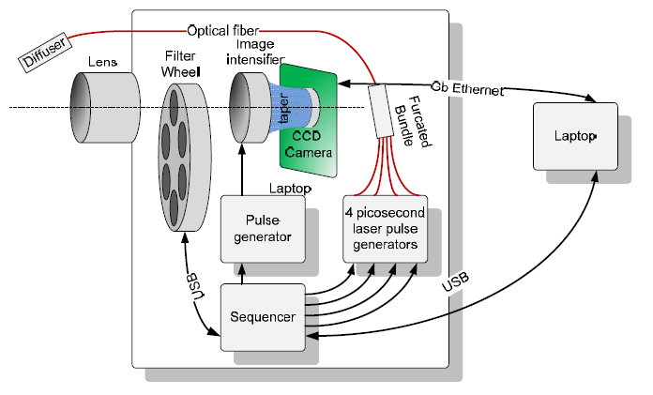

Slide 31

Picosecond Measurements and Applications
20th century was century of ELECTRONICS
21st century will be century of PHOTONICS
(6 Nobel Prizes of this century is related to PHOTONICs)
PHOTONICS is the science and technology
of generating,
controlling and
detecting photons
Single photon detection is a crucial part of PHTONICS

Slide 32
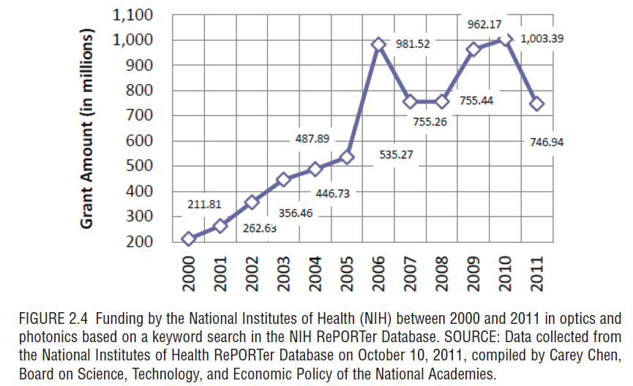
Depicted from book “Optics and Photonics, Essential Technologies for Our Nation (2013)”

Slide 33
Time Measurement & Photon Detectors
Precise Time Measurement is needed in many fields of the science and technology
Time Measurement often associated to single photon detection and timing
Regular Timing Technique
Vacuum PMT; Si-PMT; APD; HPD
Rate: few MHz
Resolution (error): 50-100 ps
Time drift: ~1 ps/s
Generate nanosecond scale electronic signals
RF Timing Technique
Streak Camera
Rate: few 10 KHz
Resolution (error): 1 ps
Time drift: ~10 fs/s
Do not generate nanosecond signals
RF Photo-Multiplier Tube
Rate: few MHz and higher
Resolution (error): 1 ps
Time drift: ~10 fs/s
Generate ns signals
A. Margaryan et al., Nucl. Instr. and Meth. A 566, 321, 2006; US Patent 8,138,460 B1

Slide 34
Single photon imaging
FLIM - Fluorescence Lifetime Imaging
FRET - Foster Resonance Energy Transfer
STED - Stimulated Emission Depletion super resolution microscope
(Nobel Prize, 2014)
DOI - Diffuse Optical Imaging
TOF-PET-Time of Flight Positron Emission Tomography
FLIM is a unique and versatile tool to be used by scientists working at the multi-disciplinary interface of biology, chemistry, physics and engineering. Borst&Visser-2010
A. Margaryan, J. Annand. Radio Frequency Photo Multiplier Tube, Armenian Journal of Physics 8 (3), 122, 2015
34
34

Slide 35
STED Microscope (Nobel prize 2014)
RF PMT
RF STED NANOSCOPE
Applications
Biomedical Studies
Nanotechnologies
RF PMT will open window into the PICOSECOND TIME DOMAIN

Slide 36
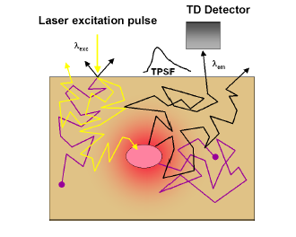
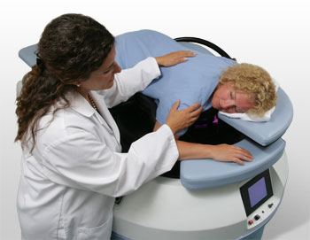
Diffuse Optical Tomography (DOT)
DOT is a promising future technology for breast cancer screening in its early stages
SoftScan: www.art.ca
RF PMT is very suited for DOT applications
and could essentially improve its characteristics

Slide 37
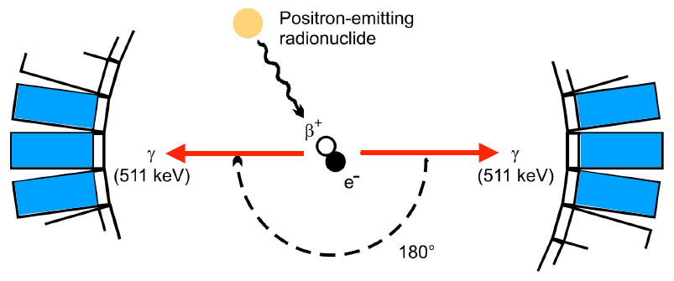
Schematic of the Positron-Emission Tomography (PET)

Slide 38
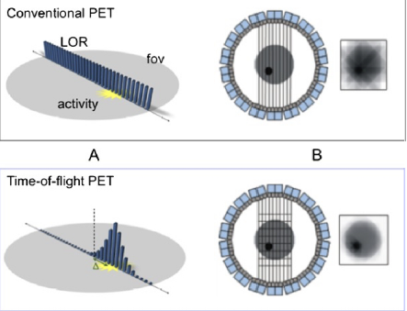
Advantages of the Time-of-Flight PET
Dream ToF PET: ΔT = 25 ps→Δx = 4 mm
CALIPSO, PETALO, ….
A. Margaryan, V. Kakoyan, S. Knyazyan. TOF PET with RF PMT, Workshop on timing detectors, Cracow, 2010

Slide 39
Establishing New Industry
Photo-cathode based industry
Photonics, Optoelectronics
Pico-electronics
Photek Ltd., UK (Photo-cathode based instruments):
No. of Employees 50, Revenue ~8 million USD
Hamamatsu, Japan (Photo-cathode based instruments, optoelectronics):
No. of Employees 20000, Revenue ~1billion 300million USD
Establishing a new industry in Yerevan: Yerevan Optoelectronics
Notes:
39
39

Slide 40
7 priciples of IDeA
Initiatives for Development of Armenia – Ruben Vardanyan
A long-term vision and plan spanning several decades;
Its scale and symbolic importance;
Collegiality and internationality;
Multiplier effect (infrastructure, social, cultural);
Local community involvement;
Gradual operational self-sufficiency;
Meeting high international standards and creating a new benchmark locally.
Notes:
40
40

Slide 41
2018
The light speed versus the observer: the Kennedy–Thorndike test from GRAAL-ESRF
VG Gurzadyan, AT Margaryan The European Physical Journal C 78 (8), 607
Active Oxygen Target for Studies in Nuclear Astrophysics with Laser Compton Backscattered γ-ray Beams
R Ajvazyan, JRM Annand, DL Balabanski, N Grigoryan, V Kakoyan, ...Particles 1 (1), 9
Direct measurements of the lifetime of medium-heavy hypernuclei
X Qiu, L Tang, C Chen, A Margaryan, SA Wood, P Achenbach, ...Nuclear Physics A 973, 116-148
2017
Compton Edge probing basic physics at Jefferson Laboratory: light speed isotropy and Lorentz invariance
V Gurzadyan, D Gaskell, V Kakoyan, C Keppel, A Margaryan, ...arXiv preprint arXiv:1706.08907
Single Photon THz Timer
A Margaryan, J Annand, R Ajvazyan, H Elbakyan, L Gevorgian, ...
Armenian Journal of Physics 10 (1), 23-29
High precision momentum calibration of the magnetic spectrometers at MAMI for hypernuclear binding energy determination
A Margaryan, JRM Annand, P Achenbach, R Ajvazyan, H Elbakyan, ...
Nuclear Instruments and Methods in Physics Research Section A: Accelerators …
High-Resolution Decay-Pion Spectroscopy of Hypernuclei
P Achenbach, F Schulz, S Nagao, S Aulenbacher, J Beričič, S Bleser, ...
Proceedings of the 12th International Conference on Hypernuclear and Strange …

Slide 42
2016
Ground-state binding energy of from high-resolution decay-pion spectroscopy
A1 Collaboration
Nuclear Physics A 954, 149-160
Experimental investigations of the hypernucleus Λ4H
P Achenbach, F Schulz, S Aulenbacher, J Beričič, S Bleser, R Böhm, ...
EPJ Web of Conferences 113, 07001
2015
Radio Frequency Photo Multiplier Tube
A Margaryan, J Annand, Armenian Journal of Physics 8 (3), 122-128
A radio frequency helical deflector for keV electrons
L Gevorgian, R Ajvazyan, V Kakoyan, A Margaryan, JRM Annand
Nuclear Instruments and Methods in Physics Research Section A: Accelerators …
Observation of H Λ 4 Hyperhydrogen by Decay-Pion Spectroscopy in Electron Scattering
A Esser, S Nagao, F Schulz, P Achenbach, CA Gayoso, R Böhm, ...
Physical review letters 114 (23), 232501
Progress of the Hypernuclear Decay Pion Spectroscopy Program at MAMI-C
S Nagao, P Achenbach, N Arai, CA Gayoso, R Böhm, O Borodina, ...
Proceedings of the 2nd International Symposium on Science at J-PARC

Slide 43
2014
Alpha-spectroscopy of Cf-252 decays: A new approach to searching for the octoneutron
H Gulkanyan, A Margaryan arXiv preprint arXiv:1409.1772
Recent Studies of Hypernuclei Formation with Electron Beams at MAMI
P Achenbach, CA Gayoso, R Böhm, ...Few-body systems 55 (8-10), 887-892
Picosecond photon detectors for the LHC
A Margaryan, R Ajvazyan, S Zhamkochyan, J Annand
Acta Physica Polonica B, Proceedings Supplement 7 (4), 759-766
Hypernuclear decay pion spectroscopy at Mainz Microtron
S Nagao, P Achenbach, N Arai, CA Gayoso, R Böhm, O Borodina, ...
Proceedings of the 12th Asia Pacific Physics Conference (APPC12), 013079
Kaon Tagging at 0° Scattering Angle for High-Resolution Decay-Pion Spectroscopy
A Esser, P Achenbach, N Arai, ...EPJ Web of Conferences 66, 11011
Delayed Pion Spectroscopy of Hypernuclei
A Margaryan, P Achenbach, R Ajvazyan, J Annand, F Garibaldi, ...
2013
Prospects for hypernuclear physics at Mainz: From KAOS@ MAMI to PANDA@ FAIR
A Esser, S Nagao, F Schulz, S Bleser, M Steinen, P Achenbach, ...Nuclear Physics A 914, 519-529
Single Photon THz Timer with Radio Frequency PhotoMultiplier Tube
A Margaryan International Workshop on New Photon-detectors 158, 042
Decay pion spectroscopy of electro-produced hypernuclei
K Tsukada, P Achenbach, CA Gayoso, ...Few-body systems 54 (1-4), 375-379

Slide 44
Summary
Low-pressure MWPC technique: applications in nuclear physics
Two-angle, two-velocity FF detector;
Low-EneRgy Nuclear Interaction Chamber (LERNIC).
RF timing technique: applications in life science, material science, fundamental, nuclear & high energy particle physics …
RF heavy ion time-zero detector;
RF PMT & RF Streak Camera;
3H TCSPC technique.
Proposal for establishing a photocathode based industry in Armenia
Notes:
44
44

Slide 45
Authors-participants
R. Ajvazyan;
H. Vardanyan;
N. Grigoryan;
S. Zhamkochyan;
H. Elbakyan;
V. Khachatryan;
P. Khachatryan;
S. Knyazyan;
G. Marikyan;
L. Parlakyan;
V. Kakoyan;
ICTC A2390.
Local Collaborators: L. Gevorgian, V. Gurzadyan, H. Gulkanyan, ….
Notes:
45
45

Slide 46
Thank You

